Slide 1
🚚
Business Problem
Late and unpredictable deliveries may be hurting customer satisfaction on the Olist marketplace. This analysis investigates what drives delivery delays and how they impact customer reviews, to help management improve logistics and protect platform reputation.
OLIST MARKETPLACE
Delivery Analytics
Report
-Riya Bhardwaj
📦 ~99K Orders
🐍 Python Analysis
📊 Looker Studio

Slide 2
Data & Methodology
Olist Brazilian E-Commerce Dtaset · 2016–2018
📦
Dataset: ~99,000 orders
Merged from: orders · payments · reviews · products · sellers tables
🧹 Data Cleaning (Python · Pandas)
📊 Visualization (Looker Studio)
→ Handled missing values across all tables
→ Review score distributions
→ Removed duplicate records
→ Late vs on-time order breakdowns
→ Filtered statistical outliers
→ Payment method analysis
→ Created delivery-delay metric
(estimated vs actual delivery date)
→ Category-level revenue breakdown
→ Merged tables on order_id
→ Correlation heat-maps

Slide 3
Key Findings
5 data-backed insights from the Olist analysis
6.5%
2.32 ★
4.21 ★
Orders delivered
late
Avg review score
(late orders)
Avg review score
(on-time orders)
−0.045
73.8%
Correlation: delay
vs freight cost
Orders paid by
credit card
⚡ Late deliveries drive a ~45% drop in review scores — the single biggest satisfaction lever identified.

Slide 4
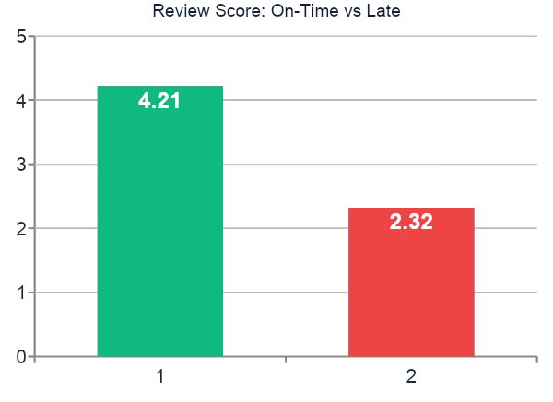
Deep-Dive: Delivery Delay & Satisfaction
Impact analysis — review score by delivery status
📌 The Core Insight
● ~45% review score drop when an order is late.
● Only 6.5% of orders are late — the problem is targeted, not systemic.
● Focused fixes on this narrow segment can meaningfully lift overall satisfaction.
● No need to overhaul the entire logistics chain — precision beats scale here.
🎯 Fixing the 6.5% late segment is a high-ROI, low-effort opportunity relative to the overall satisfaction impact.

Slide 5
Strategic Recommendations
Three high-impact actions for Olist management
01
🔍
Root-Cause Investigation
Identify specific sellers, regions, and carriers behind the 6.5% late orders. Prioritize audits where delay frequency is highest. Implement seller-level SLAs with penalties for repeated late fulfilment.
02
💳
Diversify Payment Methods
Reduce over-reliance on credit cards (73.8%). Offer incentives for boleto, PIX, and debit — lowering processing fees and concentration risk. Partner with fintech providers for buy-now-pay-later options.
03
📈
Category-Focused Marketing
Increase seller acquisition and marketing spend on high-value categories: PCs, electronics, and appliances. Higher average order value lifts revenue per shipment without needing more volume.

Slide 6
Expected Business Impact
Projected outcomes and success metrics
⭐
💳
💰
Customer Satisfaction
Payment Resilience
Revenue per Order
Fixing the late-delivery segment can lift average review scores platform-wide and reduce customer churn driven by negative delivery experiences.
Diversifying payment options reduces processing-fee exposure and platform risk from over-concentration in a single payment method.
Category-focused marketing on high-value items increases average order value — growing revenue without requiring additional order volume.
📏 Success Metrics
✓ Late delivery %
✓ Review score trend
✓ Payment method mix
✓ Avg order value by category

Slide 7
Limitations & Next Steps
Honest boundaries and the path forward
⚠️ Limitations
🚀 Next Steps
Correlation ≠ Causation
1
Controlled Analysis
We cannot confirm late delivery directly causes lower reviews — confounders may exist.
Run a regression model isolating delivery delay as a variable, controlling for product type, price, and region.
Geographic Scope
2
Seller/Region Drilldown
Data is limited to Brazil 2016–2018; results may not generalize to other markets or periods.
Investigate root causes behind the 6.5% late orders at seller and geographic granularity.
Self-Reported Reviews
3
Live Monitoring Dashboard
Customer reviews are subjective and may reflect factors beyond delivery alone.
Build a real-time delivery KPI dashboard in Looker Studio for ongoing tracking by ops teams.
Thank you — Questions welcome | Riya Bhardwaj

